Slide 1
SENTTER (Live Sentiment Analysis of Twitter Data)

Slide 2
HELLO!
I am Chaudhary Jagrit Varshney
Junior Year CSE Undergrad Student
GLA University, Mathura

Slide 3
INTRODUCTION
So, what is Sentiment Analysis?

Slide 4
Sentiment Analysis
“Sentiment Analysis is the process of computationally identifying and categorizing opinions expressed in a piece of text, especially in order to determine whether the writer’s attitude towards a particular topic, brand, etc. is positive, negative or neutral.”

Slide 5
Twitter
“Twitter is an American online news and social networking service developed in March 2006 by Jack Dorsey, Noah Glass, Biz Stone and Evan Williams.”

Slide 6
335,000,000
Whoa! That’s a big number!
This is the total number of monthly active twitter users.

Slide 7
711,000,000$
500,000,000
80%
That’s a lot of money
Tweets sent per day
Twitter users on mobile

Slide 8
The process is easy
PRE-PROCESSING
MAKING MODEL
EVALUATION
SENDING QUERY
PREDICTION
RESULTS

Slide 9
DATASETS & PRE-PROCESSING
So, what is pre-processing and why do we need to do it?

Slide 10
Datasets
“Many labeled sentiment datasets have been created, especially for Twitter posts & Amazon product reviews.
Apart from using these datasets, a user can create a dataset by crawling using twitter API.”

Slide 11
Datasets
Stanford Twitter Sentiment
Sentiment Strength Twitter Dataset
Amazon Reviews for Sentiment Analysis
Sanders Corpus

Slide 12
Pre-Processing
“Data pre-processing is a data mining technique that involves transforming raw data into an understandable form.”

Slide 13
Pre-Processing
Noice Reduction
Removing numbers
Removing punctionations
Removing stop words

Slide 14
PREDICTING SENTIMENTS
So, how to predict sentiments?

Slide 15
Machine Learning
Here, I have used Voting Classifier of Ensemble Technique using 3 base classifiers – Logistic Regresion, Multinomial Naïve Bayes and Stochastic Gradient Descent

Slide 16
DEPLOYING MODEL ON WEB
So, how to predict sentiments in real time?

Slide 17
Model Deployment
Here, I have used Flask to deploy the model.
The trained models are used at backend, queries are fired at front end.
The Flask app is hosted at Heroku and the domain is at Hostinger.

Slide 18
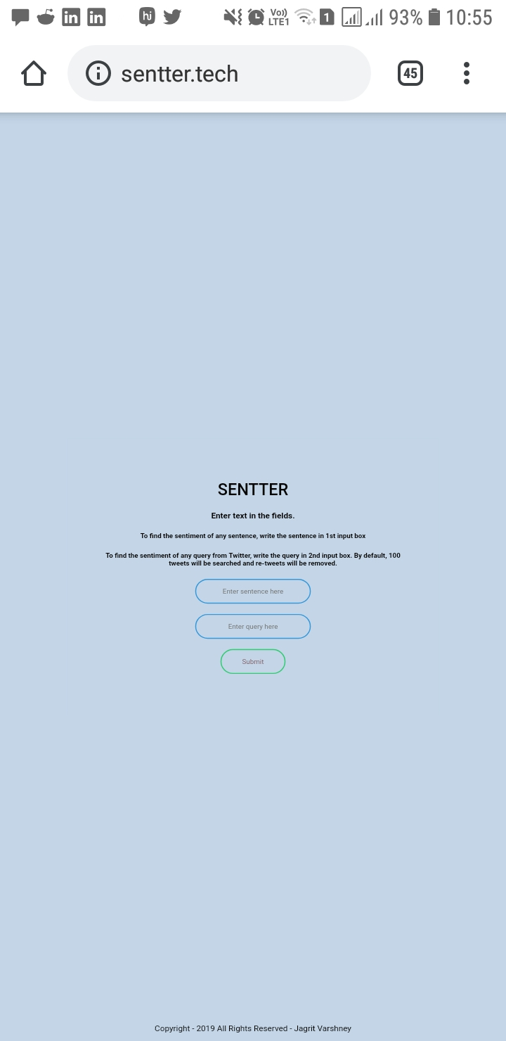
MOBILE VIEW

Slide 19
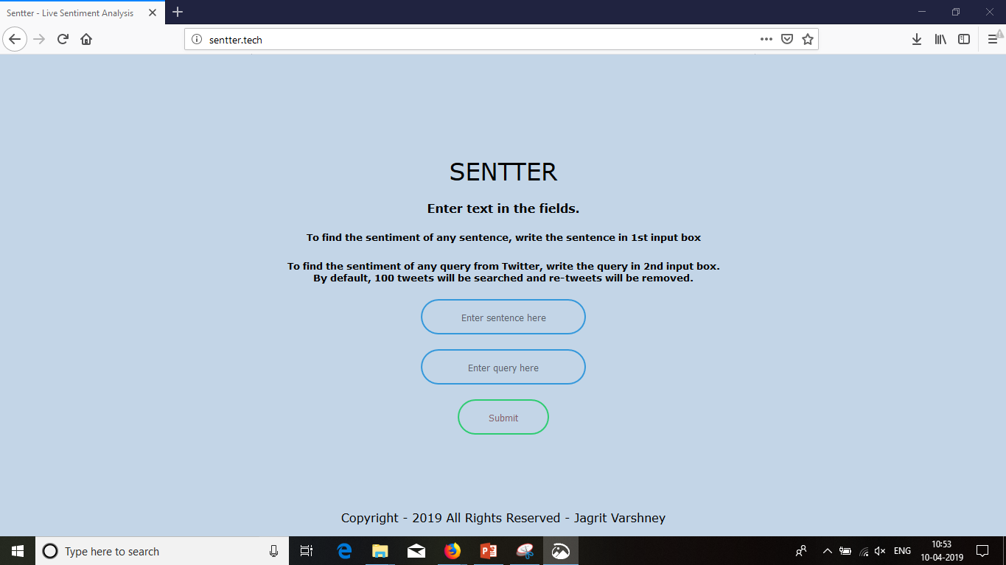
DESKTOP VIEW

Slide 20
www.sentter.tech
You can find the sentiment analysis tool here

Slide 21
CONCLUSION
So, what is the result of all this that we have done?

Slide 22
Mainly divided into three categories
And it can be furthur divided to various other sentiments in future.

Slide 23
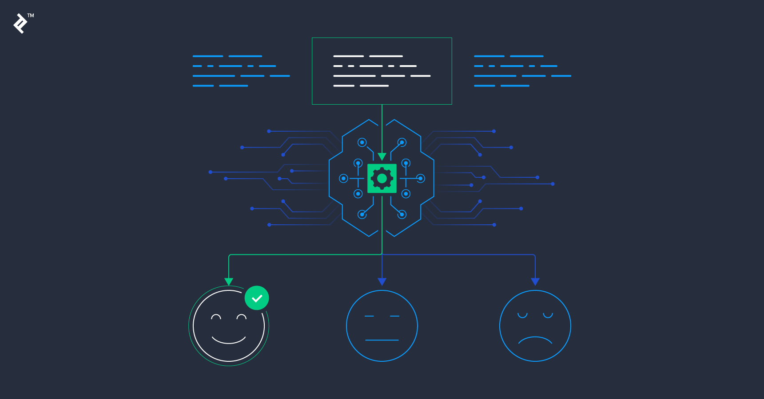

Slide 24
THANKS!
Any questions?
You can find me at:
LinkedIn - https://www.linkedin.com/in/jagritv/
Github - https://github.com/jagrit-varshney/
View my web portfolio at - http://jagrit.me/

